Slide 1







Salford & Co.
01/10
KPI Monthly
Presentation
A dynamic review of Salford & Co. performance and key metrics, highlighting achievements and strategies for success in January 2025.
@reallygreatsite

Slide 2



Salford & Co.
02/10
Table of contents
This presentation outlines key performance metrics, financial achievements, operational efficiency, and customer satisfaction insights to highlight our progress and strategy.
01
Introduction
05
Employee Retention Rate
02
Monthly Income
06
Net Profit Margin
03
Customer Satisfaction Level
07
Conclusion
04
Operational Productivity
08
Thank You

Slide 3






Salford & Co.
03/10
Introduction
KPI Objectives
Evaluate company performance using measurable metrics to ensure alignment with business goals and industry standards.
Focus Areas
Purpose
Highlight key performance indicators across finance, operations, and customer satisfaction to provide a comprehensive overview.
Identify improvement opportunities, address challenges, and guide strategic decision-making for sustainable growth.

Slide 4





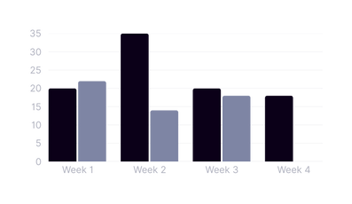
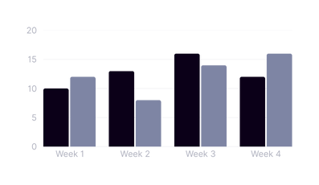
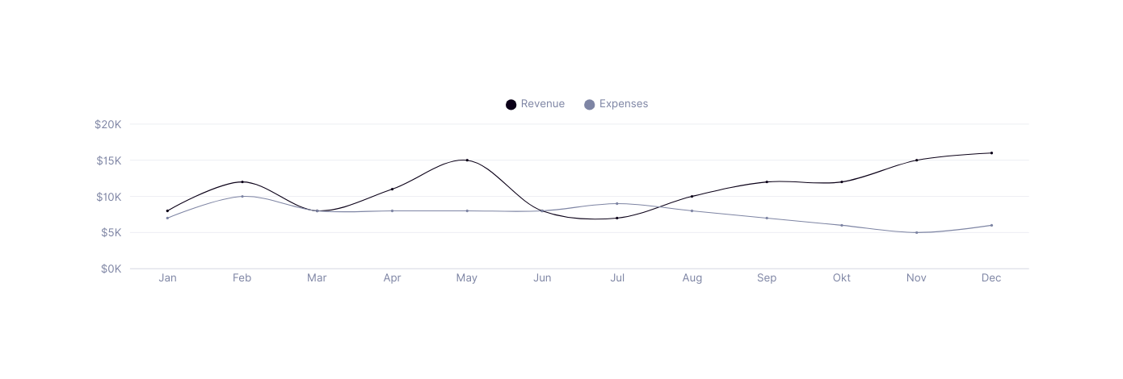
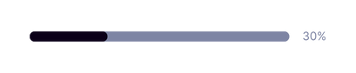
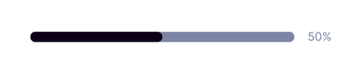

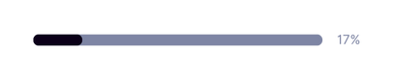
Salford & Co.
Monthly Income
04/10
Total Revenue
Total Expenses
Difference
Net Profit Margin
$93,745
$66,830
$12,915
+5.6%
From last month
+5.6%
From last month
+5.6%
From last month
30%
The difference between revenue and expenses
Revenue per Month
Revenue % by Category
Showing data for top Session
01
Category A
02
Category B
03
Category C

Slide 5







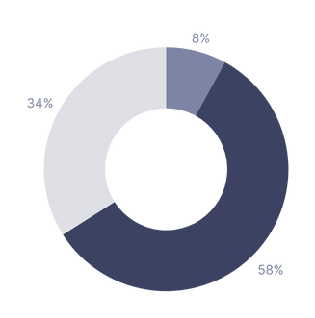
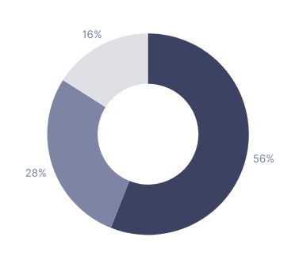
Salford & Co.
Customer Satisfaction Level
05/10
Total Agents
Customer Satisfaction Score
Net Promoter Score
Customer Effort Score
40
Avg. Response Time
15 Min(s)
66%
32.54%
5.12
Response Rate
22.16%
+5.6%
From last period
+4.6%
From last period
-8.2%
From last period
Customer Satisfaction Scores
Net Profit Scores
Good
Promotors
Neutral
Detractors
Bad
Passive

Slide 6




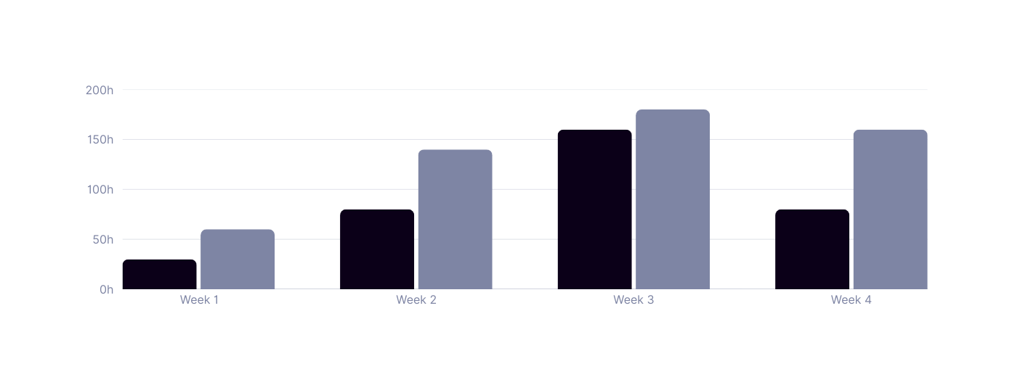

Salford & Co.
Operational Productivity
06/10
Activity
Efficiency
Task Overview
Work Hour
52.6%
48.1%
$120,000
+5.6%
from last month
+2.6%
from last month
-1.2%
from last month
View Report
View Report
View Report
Work Hour
Productivity
Total Working
464 h
520 h
$2500 - $2999
$3000 - $3999
$4000 - $4999
Revenue % by Category
Productivity
Total Working
412
315

Slide 7
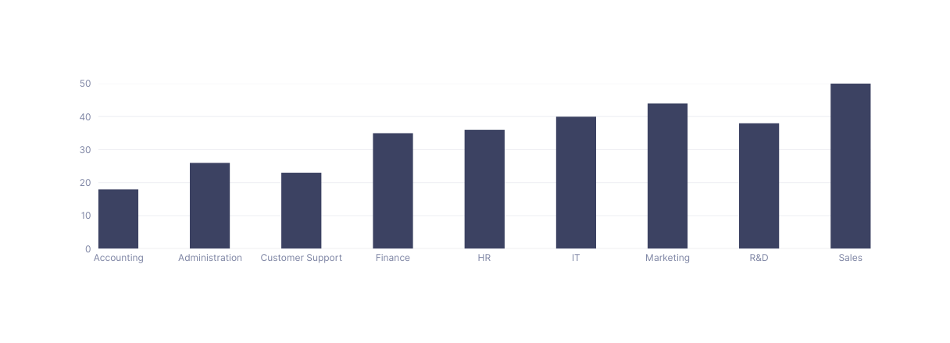
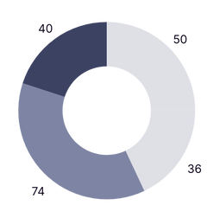

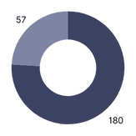
Salford & Co.
Employee Retention Rate
07/10
Employee Count
Attrition
Attrition Rate
Avg Age
Avg Salary
Avg Years
237
310
14.86%
310
66.7K
7.23
Employee Count by Departement
Employee Count by Salary Range
$2500 - $2999
$3000 - $3999
$4000 - $4999
$5000 - $5999
Employee Details
Employee Count by Status
Name
Email
Departement
Joined Date
Experience
Employee 1
hello@reallygreatsite.com
Finance
18 January 2014
10 Years
Employee 1
hello@reallygreatsite.com
Administration
27 November 2019
5 Years
Full Time
Part Time
Employee 1
hello@reallygreatsite.com
Finance
12 April 2020
4 Years
Employee 1
hello@reallygreatsite.com
Sales
17 Agustus 2021
3 Years

Slide 8



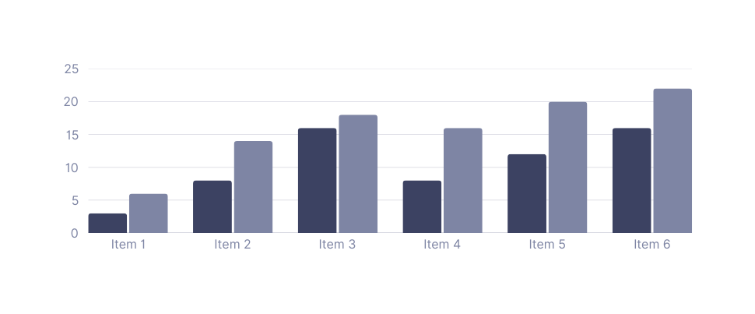



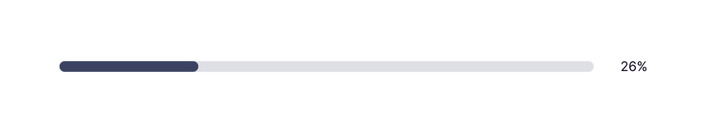
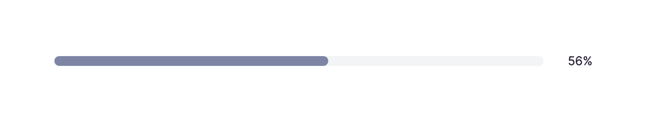
Salford & Co.
Net Profit Margin
08/10
Net Profit
Net Sales
Revenue
Month
$120,000
$280,000
$120,000
Net Profit
Gross Profit
+2.6%
From last month
-2.1%
From last month
View Report
View Report
EBITDA
Gross Profit
$150,000
$220,000
+1.5%
From last month
+5.6%
From last month
View Report
View Report
Net Profit
Gross Profit
Comparison
Net Profit
Gross Profit
2.6%
5.6%
Target 2% from last Month
Target 2% from last Month

Slide 9






Salford & Co.
09/10
Conclusion
This conclusion highlights the key achievements, areas for improvement, and strategic focus to ensure continued success and sustainable growth.
Exceeding Expectations
Areas Needing Attention
Focus Areas
The overall performance remains strong, with many key performance indicators (KPIs) exceeding their targets, showcasing effective planning and execution.
To be the best quality product provider that supports customers' lifestyles and creates sustainable value for the community. To be the best quality product.
To be the best quality product provider that supports customers' lifestyles and creates sustainable value for the community. To be the best quality product.

Slide 10








Salford & Co.
10/10
Thank You
+123-456-7890
www.reallygreatsite.com
hello@reallygreatsite.com
Thank you for your time and attention. Your support and feedback are essential to achieving our goals and delivering impactful results.
123 Anywhere St., Any City

